Slide 1
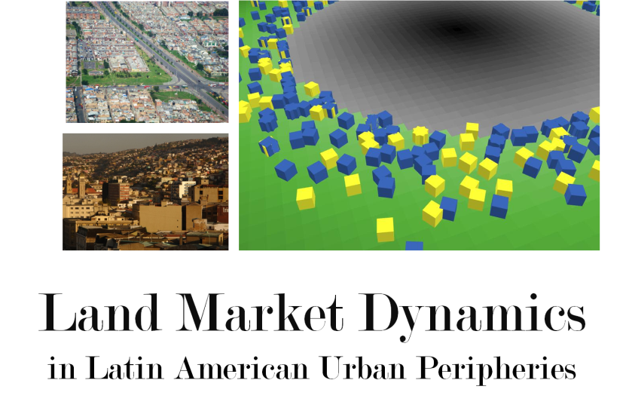

Diego Silva Ardila
Programa de
Gestión y Desarrollo Urbanos
FACULTAD DE CIENCIA POLÍTICA, GOBIERNO Y RELACIONES INTERNACIONALES

Slide 2
Latin American Cities and its peripheries
Informality..?
Modeling Land Market Dynamics
Preliminary results
Future research
Latin American Urban Peripheries

Slide 3
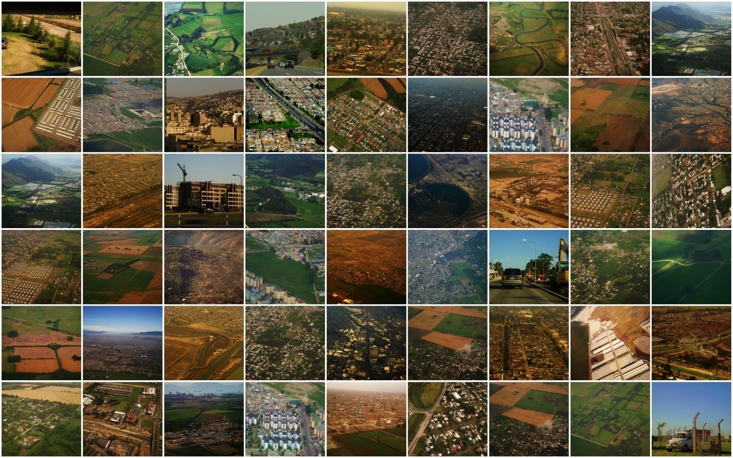
Latin American Urban Peripheries

Slide 4
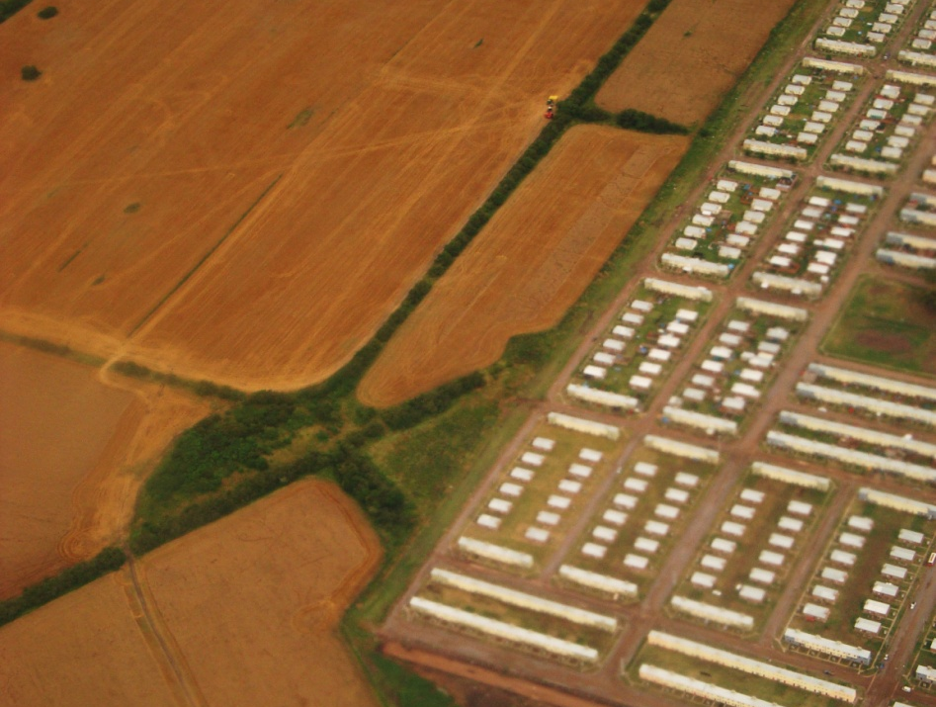
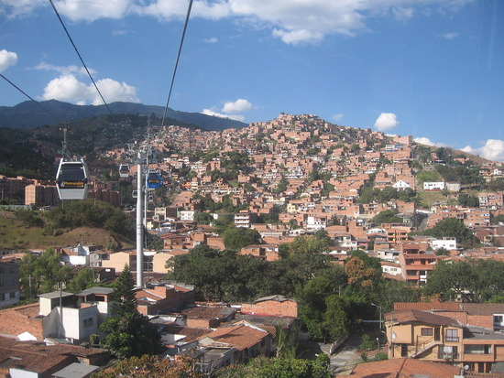
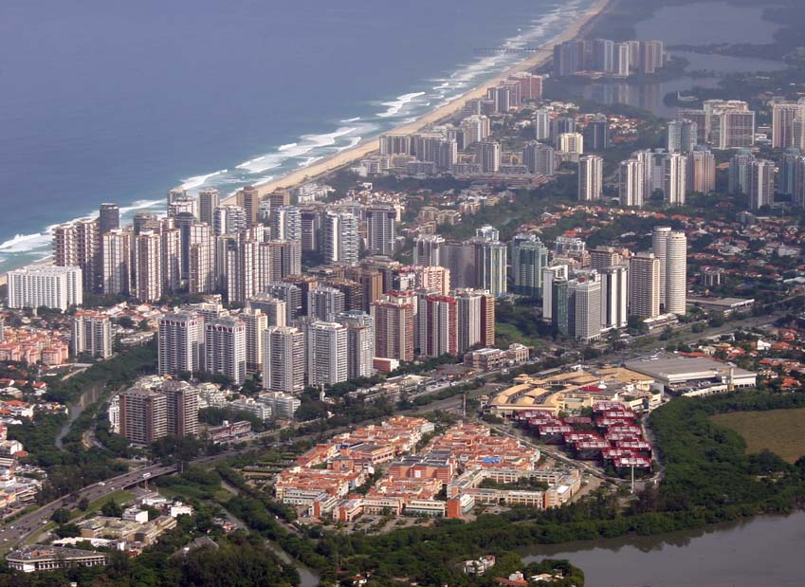
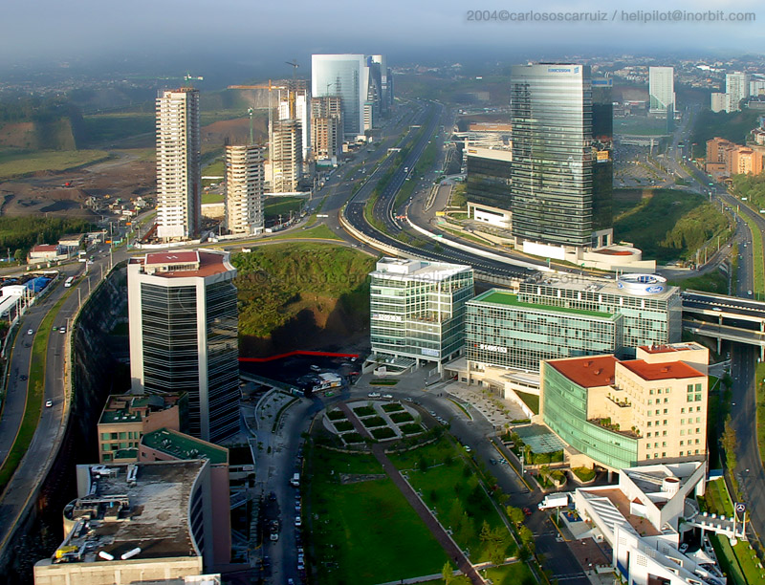
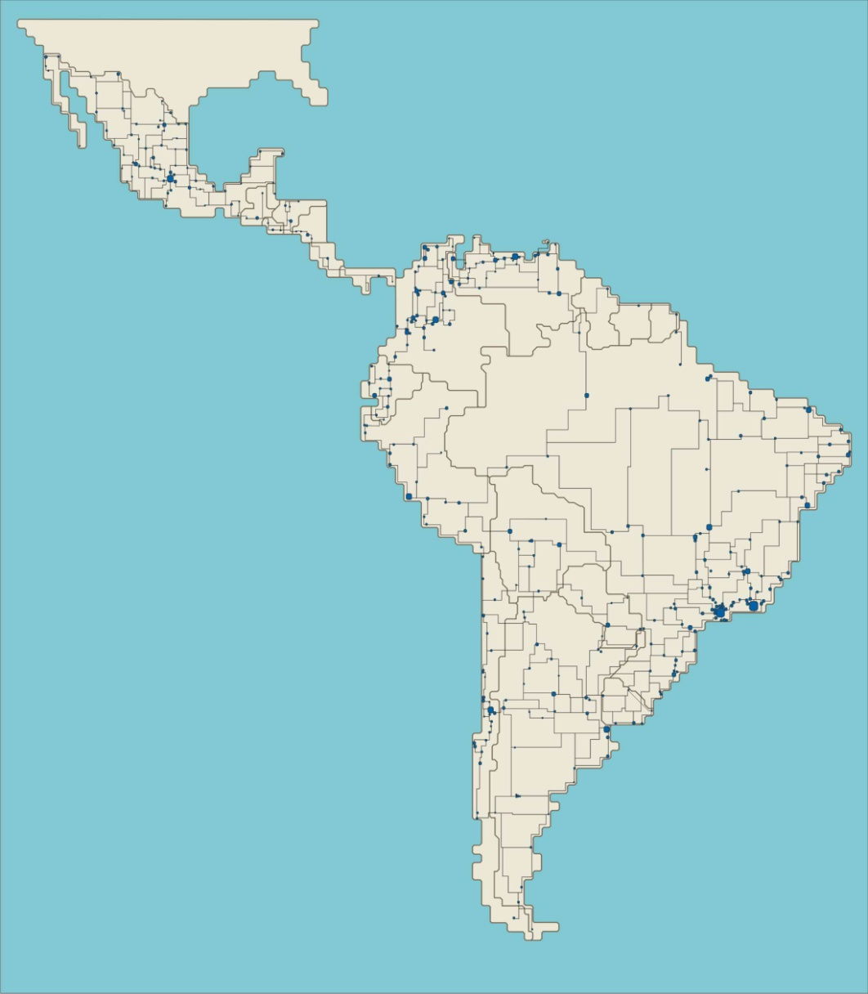
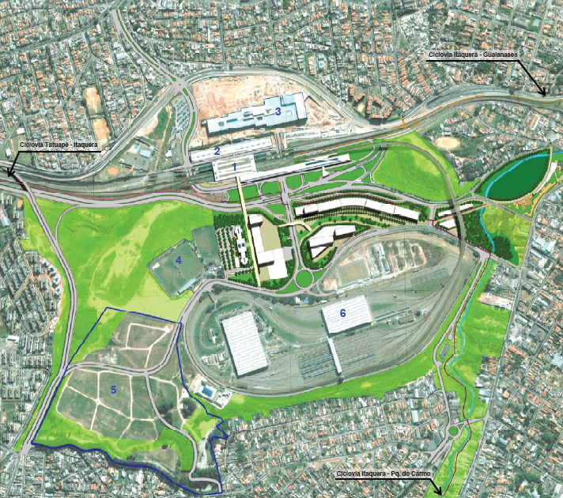
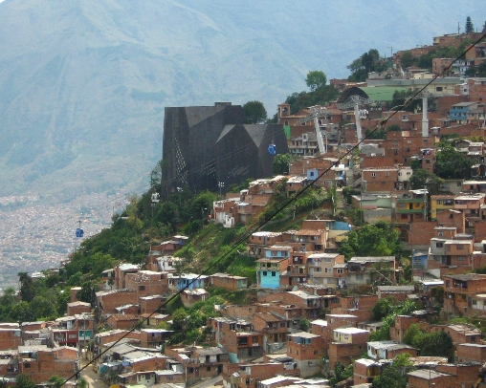
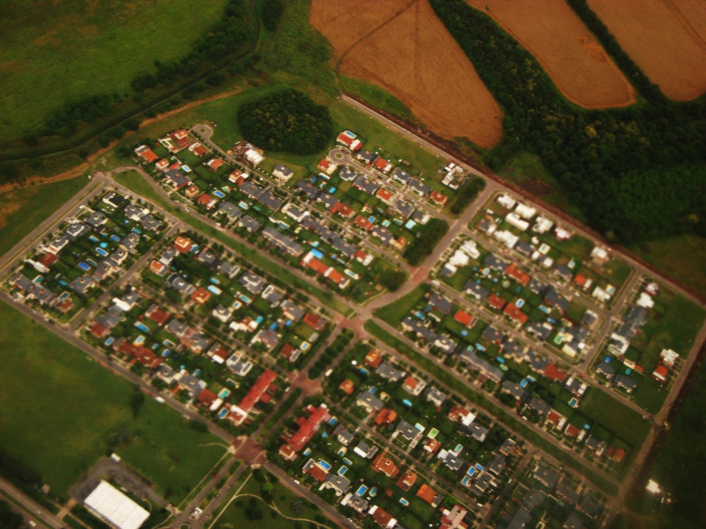
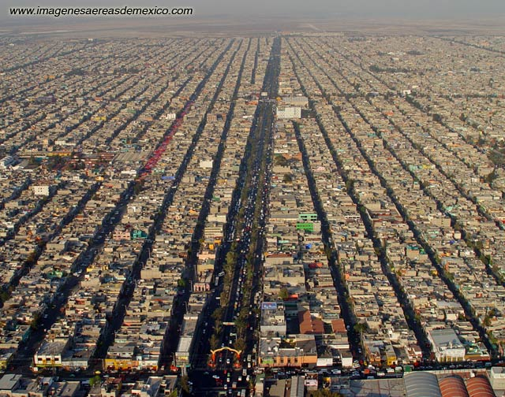
Latin American Cities or
Cities in Latin America?

Slide 5
Common Elements:
Income inequalities | Polarization
Poverty | Weak Purchase Capacity
Capitalist Housing Mechanisms
vs. Self-construction
Private property vs. Collective property
Law and Legitimacy
Centralization | Decentralization

Slide 6
Why Latin American Urban Peripheries?
Rapid growth without planning
Tension between rural and urban
High and Low income groups
- Luxury homes or escape from city
- Squatters and informal settlements
Challenge for:
- Environmental policy
- Housing policy
- Infrastructure

Slide 7
Micro-scale interactions of buyers and sellers of spatial goods
Macro-scale feedbacks of market transactions
Agent-Based Urban Land Markets: Agent's Pricing Behavior, Land Prices and Urban Land Use Change
Filatova, T; Parker, D. and van der Veen, A. (2009)
Agent-Based Land Market

Slide 8
Rural Productivity
Urban Expansion
Available Land for Urban Growth
Rural Owner
Developer
Land Value
Urbanize
Urban dwellers
Housing and Urban form
Agent-Based Land Market

Slide 9
Agent-Based Land Market
Market Structure
Rural Productivity
Sale Probability
Available LAND
Land Characteristics
Distance to CBD
Amenities
ForSale?
LAND MARKET
SUPPLY
Rural Owner
Ask formation
DEMAND
High Income
- Low Income
Bid formation

Slide 10
SUPPLY
Rural Owner
Ask formation
DEMAND
High Income
- Low Income
Bid formation
ASK
PRICE NEGOTIATION PROCESS
BID
MARKET TRANSACTION
Price
Ownership
FEEDBACKS
FEEDBACKS

Slide 11
SUPPLY
Urban Developer
Product construction
DEMAND
High Income
Low Income
  Product Purchase
PRICE
MARKET TRANSACTION
Price
Ownership
BUDGET

Slide 12
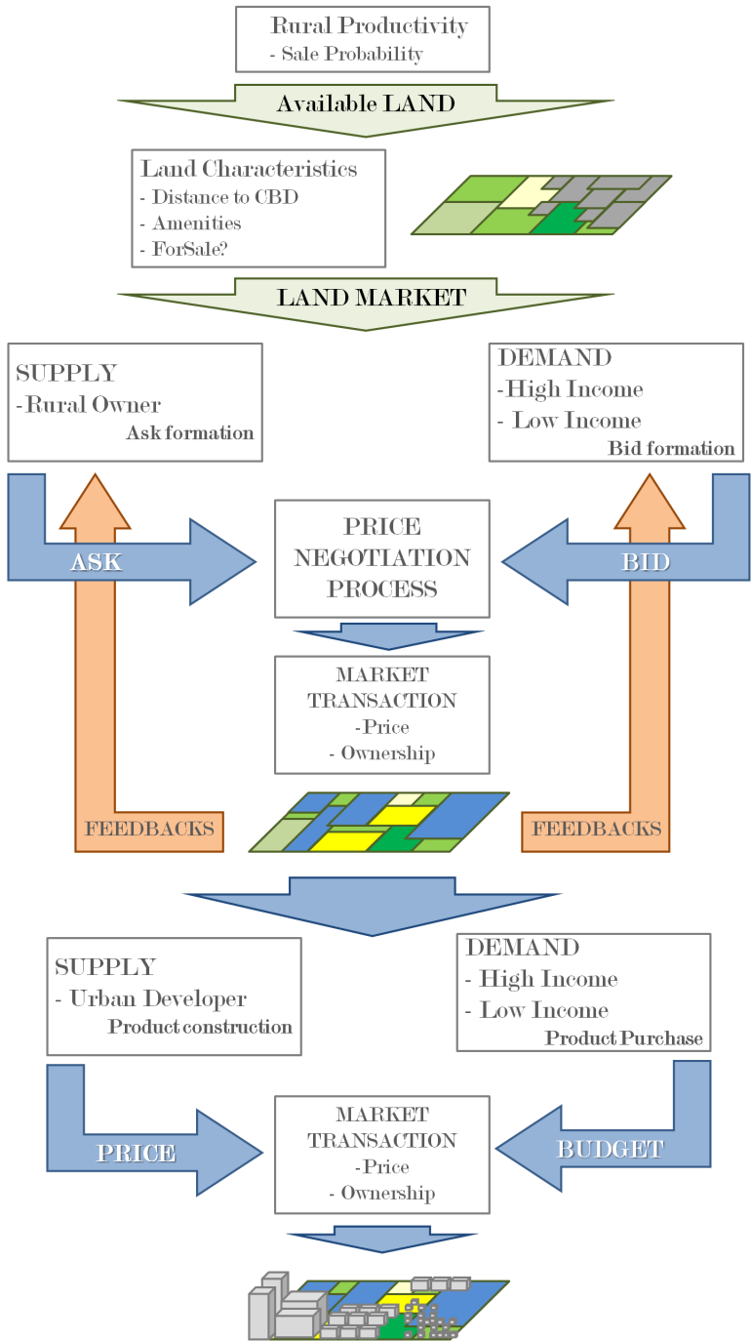
Agent-Based Land Market Model
Land to Housing
Tri-Level-Approach
NET LOGO…

Slide 13
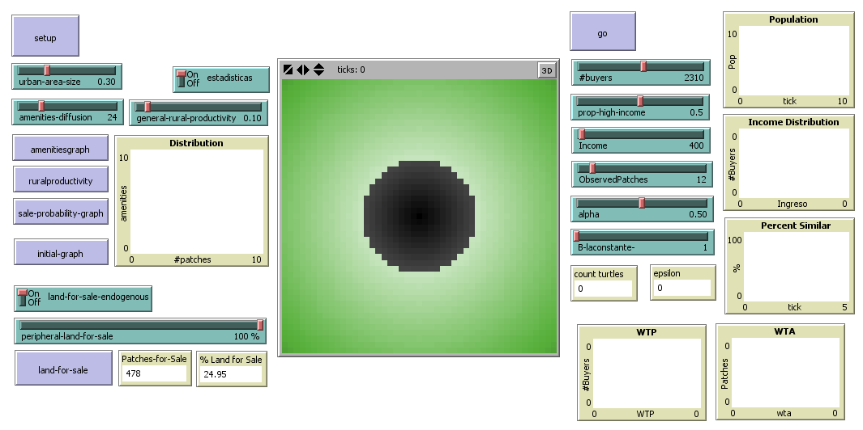
Our Agent-Based Land Market Model

Slide 14
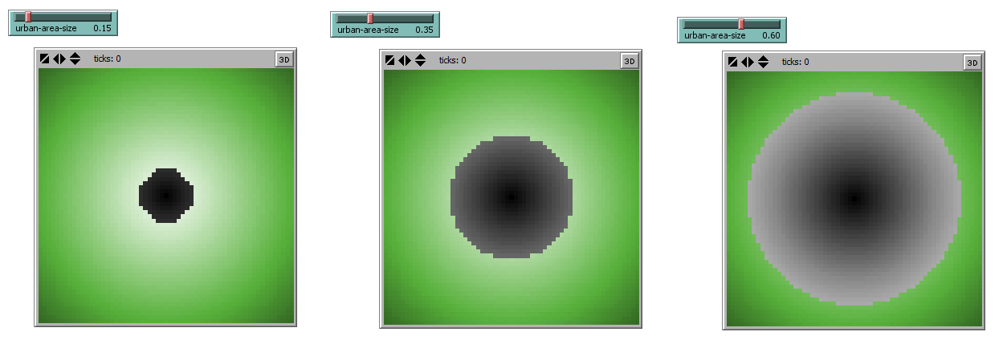
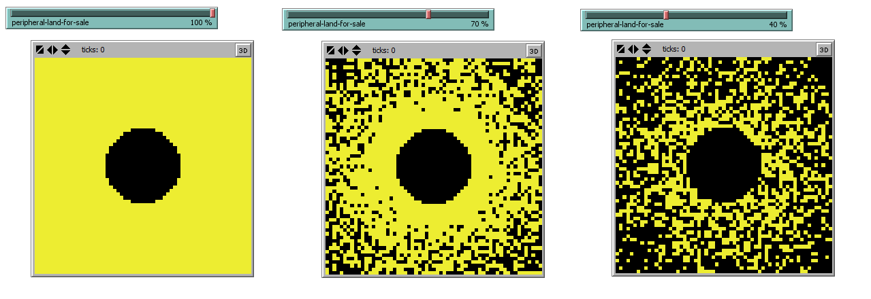
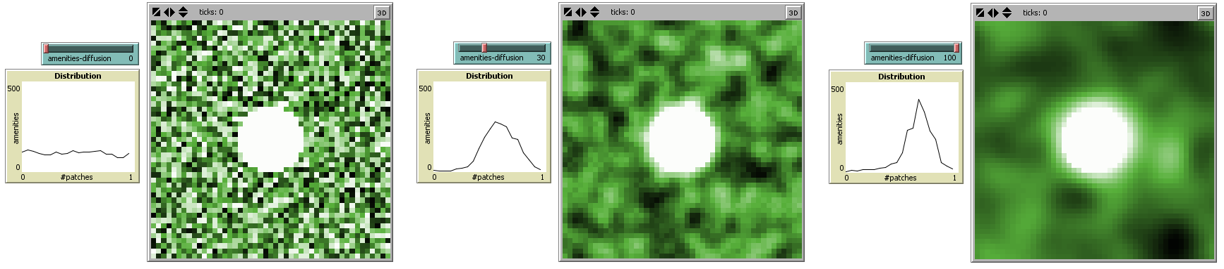
USER [sets]
-Urban area size
-Amenities difussion
-Land ForSale?
USER [sets]
-Urban area size
-Amenities difussion
-Land ForSale?
USER [sets]
-Urban area size
-Amenities difussion
-Land ForSale?
USER [sets]
-Urban area size
-Amenities difussion
-Land ForSale?

Slide 15
SETUP [ ]
- Measure and Calculate Proximity
- Sets initial price and WTA initial price
- Amenities [Random number] and difusse
- Sets ForSale? [If set by user, random with probability higher for proximity to city]
-OUTPUT: Total Patches (Urban-Rural) | Patches for Sale | Land Characteristics

Slide 16
USER [sets]
- Number of Buyers
- Proportion High-Low Income
- Income Mean
- Observed Patches
SETUP [ ]
Create buyers
[Number of Buyers and Proportion]
Assign Income to buyers | Normal Distribution

Slide 17
BID [ ]
- Sets WTA and WTP
- Sellers set their “price-ask”
- Buyers observe n parcels [Observed patches]
calculates utility
- Buyers select the patch with highest utility
- Buyers set their “price-bid”

Slide 18
TRANSACTION [ ]
-Patches select highest bid (***)
If “price-bid” higher than “price-ask”
>>> Accept >>> Transaction >>> Move
If “price-bid” low but higher than 75% “price-ask”
>>> Negotiation >>> Transaction >>> Move
If “price-bid” less than “price-ask”
>>> Reject
UPDATE [ ]
- Patches update their WTA for
Max Transaction Price of their neighbors

Slide 19
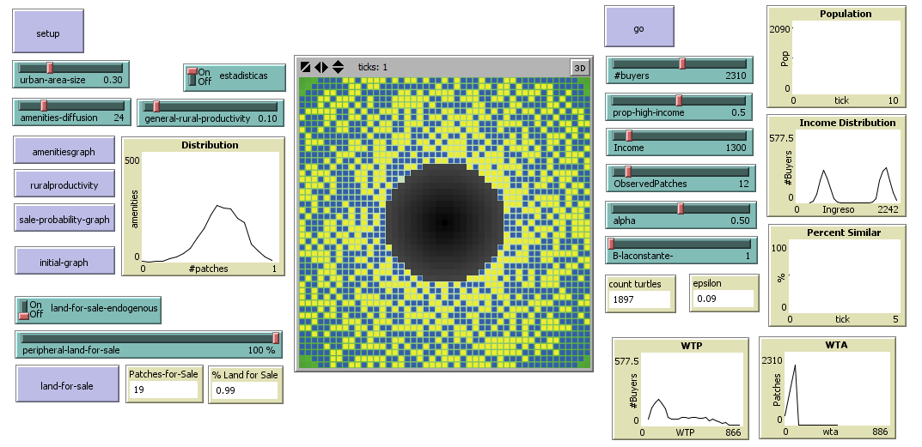
Our Agent-Based Land Market Model

Slide 20
Basic Land Market for a polarized society that permits to observe dynamics that are particular of Latin America

Slide 21
PRELIMINARY RESULTS
1. Land Markets
BLUE High Income
YELLOW Low Income
30x30 Latice
30 times for each set of parameters

Slide 22
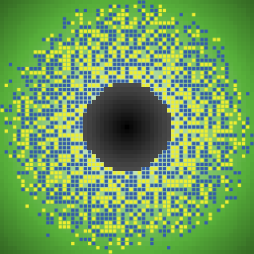
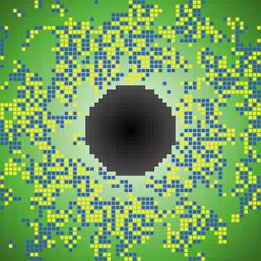
PRELIMINARY RESULTS
Low α >>> Circular growth
High α >>> ‘Zone’ Growth

Slide 23
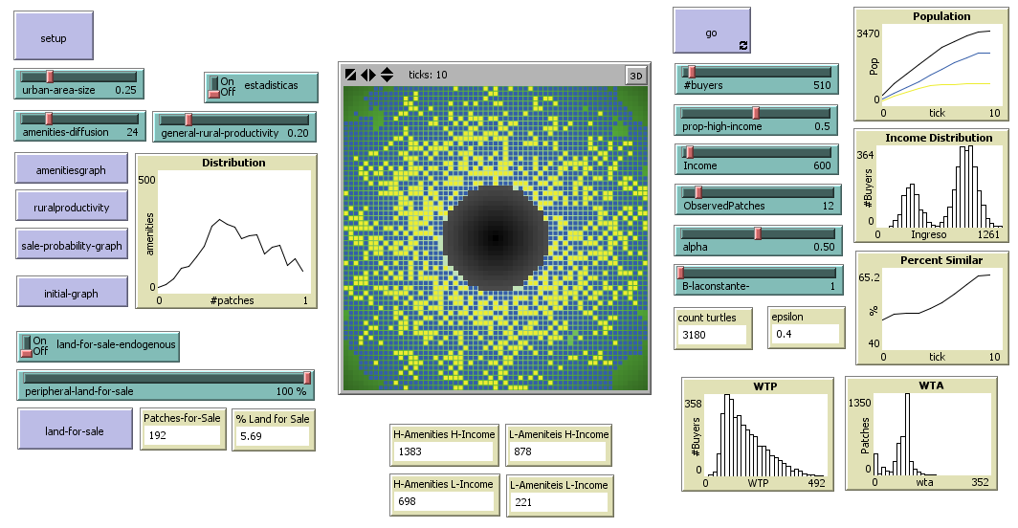
CENTRIFUGAL FORCES
High Income and Periphery

Slide 24
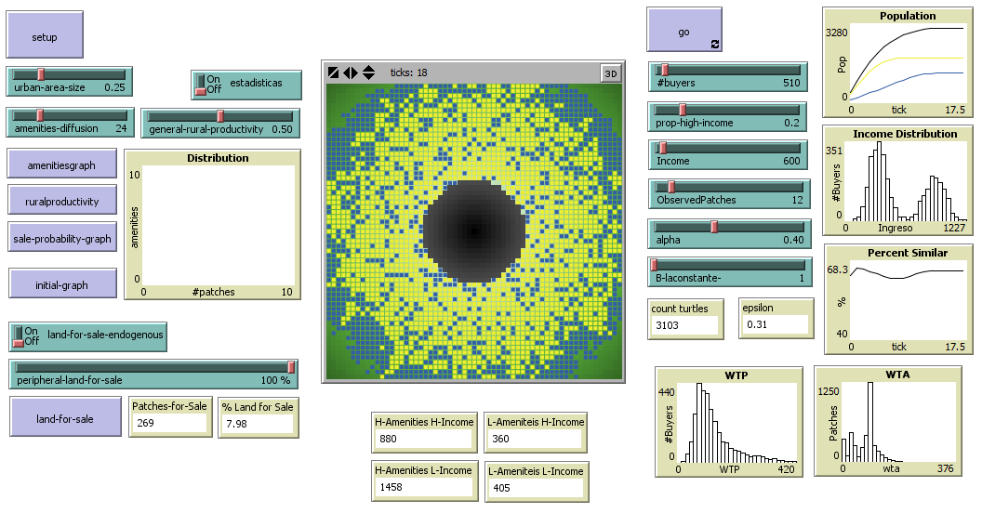
CENTRIFUGAL FORCES
High Income and Periphery

Slide 25
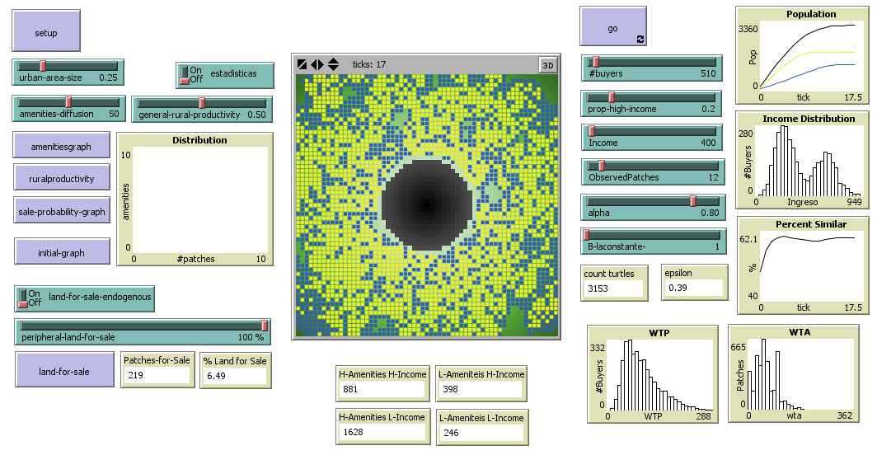

CENTRIFUGAL FORCES
Amenities as cores

Slide 26
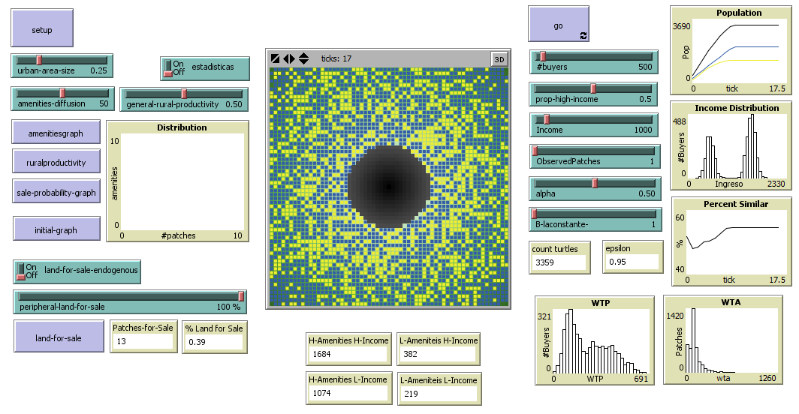
THE COST OF INFORMATION
Information and segregation

Slide 27
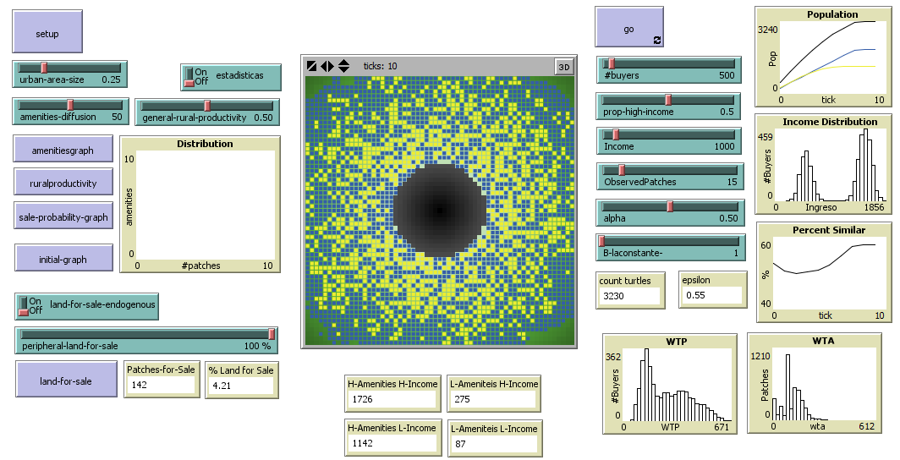
THE COST OF INFORMATION
Information and segregation

Slide 28
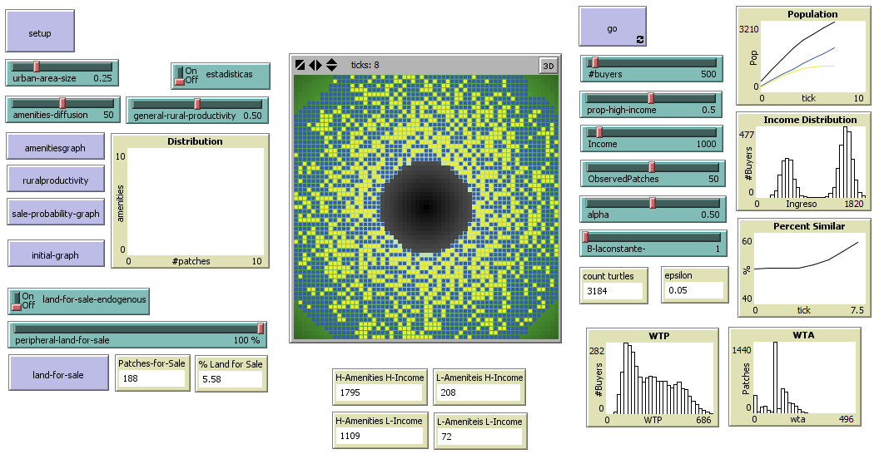
THE COST OF INFORMATION
Information and segregation

Slide 29
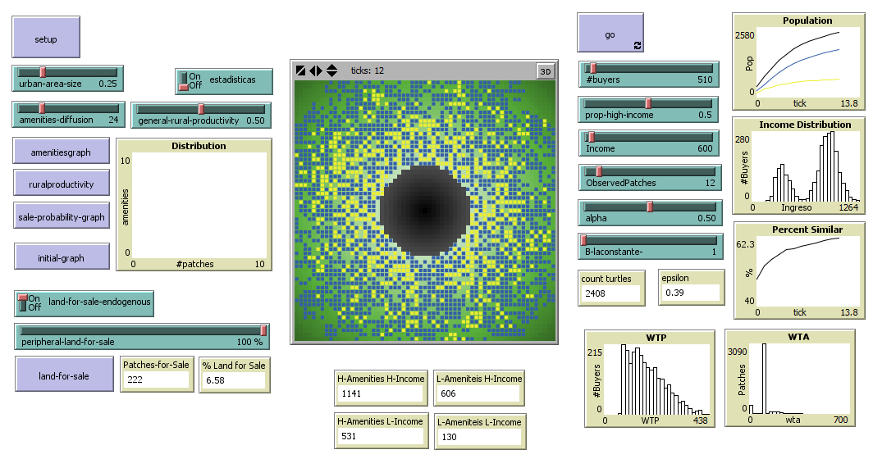
SCARCE LAND | FAST EXCLUSION
Land for Sale | Endogenous

Slide 30
FUTURE DIRECTION
Rural to Urban dynamics
Urbanization process

Slide 31
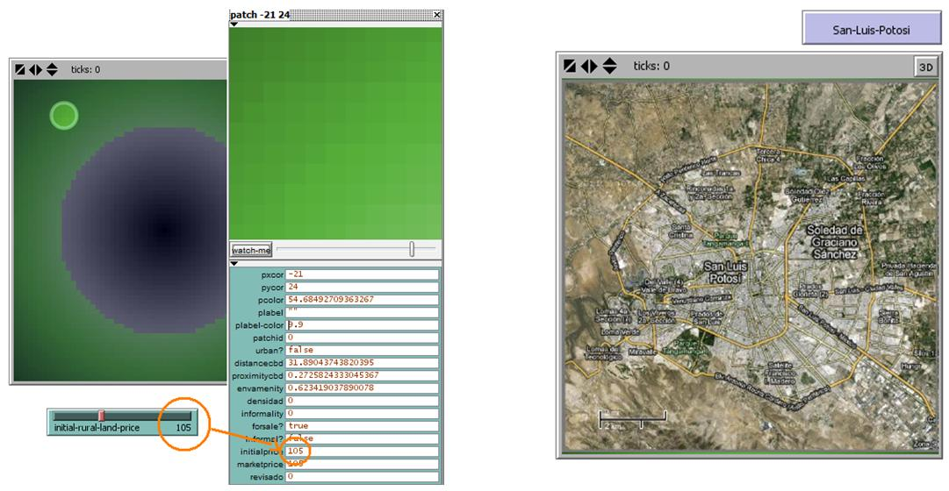
Use GIS to inform Land Characteristics

Slide 32
Heterogeneous Utilities for buyers
Financial mechanisms
Policy: Rural, Land Use and Housing
Informality

Slide 33
Informality..?
Illegal vs. Informal:
Crime vs. Economic Incentives
Private vs. Public:
No correlation with Informality
Poor or Rich?
No correlation but…
Informal markets… Informal Brokers

Slide 34
Diego Silva Ardila
Programa de
Gestión y Desarrollo Urbanos
FACULTAD DE CIENCIA POLÍTICA, GOBIERNO Y RELACIONES INTERNACIONALES

